Slide 1

Testing and Debugging, and Backwards Compatibility
Android Developer Fundamentals
Lesson 3
This work is licensed under a Creative Commons Attribution-NonCommercial 4.0 International License
Android Developer Fundamentals

Slide 2
3.3 The Android Support Libraries
This work is licensed under a Creative Commons Attribution-NonCommercial 4.0 International License
Android Developer Fundamentals
Support Libraries

Slide 3
Contents
What are the Android support libraries?
Features
Selected Libraries
Setting up and using support libraries

Slide 4
What are the Android support libraries?
More than 25 libraries in the Android SDK that provide features not built into the Android framework

Slide 5
Features

Slide 6
Support library features
Support libraries provide:
Backward-compatible versions of components
Additional Layout and UI elements, such as RecyclerView
Different form factors, such as TV, wearables
Material design and other new UI components for older Android versions
and more….

Slide 7
Backward compatibility
Always use the the support library version of a component if one is available
No need to create different app versions for different versions of Android
System picks the best version of the component

Slide 8
Support libraries versions
Libraries for Android 2.3 (API level 9) and higher
Recommended you include the v4 support and v7 appcompat libraries for the features your app uses

Slide 9
Libraries

Slide 10
v4 Support Libraries
Largest set of APIs
App components, UI features
Data Handling
Network connectivity
Programming utilities

Slide 11
v4 Support Libraries
compat—compatibility wrappers
core-utils—utility classes (eg., AsyncTaskLoader)
core-ui—variety of UI components
media-compat—back ports of media framework
fragment—UI component

Slide 12
v7 Support Libraries
Backwards compatibility
TV-specific components
UI components and layouts
Google Cast support
Color palette
Preferences

Slide 13
v7 Support Libraries
appcompat—compatibility wrappers
cardview— new UI component (material design)
gridlayout—rectangular cell (matrix) Layout
mediarouter—route A/V streams
palette—extracting color from an image
recyclerview—efficient scrolling view
preference—modifying UI settings

Slide 14
v7 appcompat library
ActionBar and sharing actions
You should always include this library and make AppCompatActivity the parent of your activities
com.android.support:appcompat-v7:24.2.1

Slide 15
Complete list of libraries
… and many more
For latest libraries and versions of libraries
Support Library Features documentation
API Reference (all packages that start with android.support)

Slide 16
Using
Android Support Libraries

Slide 17
Support libraries
Part of Android SDK and available through SDK Manager
In Android Studio, locally stored in Android Support Repository
Include in build.gradle of module to use with your project

Slide 18
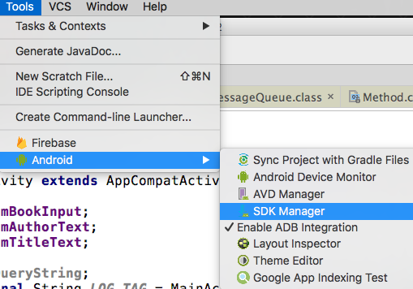
Start SDK Manager in Android Studio
Tools > Android > SDK Manager

Slide 19
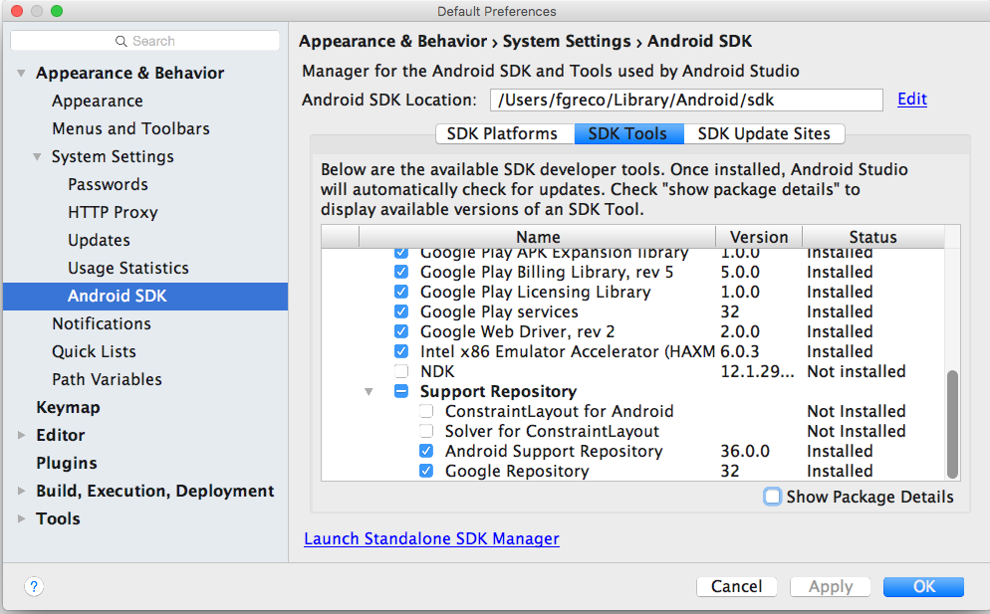
Find the Android Support Library
SDK Tools tab
Find Android Support Repository
Must be Installed
If Not Installed or Update Available
Check checkbox and Apply
In dialog, confirm components and click OK to install
When done, click Finish
Verify that it is Installed now

Slide 20
Find the dependency identifier
Open Support Library Features page
Find the feature you want
For example, the recommended v7 appcompat library
Copy the build script dependency identifier for the library
com.android.support:appcompat-v7:24.2.1

Slide 21
Add dependency to build.gradle
open build.gradle (Module: app)
In the dependencies section, add a dependency for the support library
compile 'com.android.support:appcompat-v7:24.2.0'
Update the version number, if prompted
Sync Now when prompted

Slide 22
Updated build.gradle (Module: app)
dependencies {
compile fileTree(dir: 'libs', include: ['*.jar'])
testCompile 'junit:junit:4.12'
compile 'com.android.support:appcompat-v7:24.2.0'
}

Slide 23
Learn more
Android Support Library (introduction)
Support Library Setup
Support Library Features
API Reference (all packages that start with android.support

Slide 24
What's Next?
Concept Chapter: 3.3 C The Android Support Library
Practical: 3.3 P Using the Android Support Libraries

Slide 25
END

